Slide 1
Lecture 15: k-NN Classification & Logistic Regression

Slide 2
Announcements
1. HW4 released later today
Due in 2 weeks (Oct 21)
Individual
2. Project topic assignments
Released tomorrow (every group gets assigned a TF)
Every full group got their first choice
Those with custom topics will take a day or two more processing time.
3. No Lecture on Monday! No Sections Friday or Monday.
4. Next Advanced Section: next week (Oct 14)

Slide 3
Lecture Outline
Introduction to Classification
k-NN for Classification
Why not Linear Regression?
Binary Response & Logistic Regression
Estimating the Simple Logistic Model
Classification using the Logistic Model
Multiple Logistic Regression

Slide 4
Classification

Slide 5
Advertising Data (from earlier lectures)
X
predictors
features
covariates
Y
outcome
response variable
dependent variable
TV | radio | newspaper | sales
230.1 | 37.8 | 69.2 | 22.1
44.5 | 39.3 | 45.1 | 10.4
17.2 | 45.9 | 69.3 | 9.3
151.5 | 41.3 | 58.5 | 18.5
180.8 | 10.8 | 58.4 | 12.9
n observations
p predictors

Slide 6
Heart Data
response variable Y
is Yes/No
Age | Sex | ChestPain | RestBP | Chol | Fbs | RestECG | MaxHR | ExAng | Oldpeak | Slope | Ca | Thal | AHD
63 | 1 | typical | 145 | 233 | 1 | 2 | 150 | 0 | 2.3 | 3 | 0.0 | fixed | No
67 | 1 | asymptomatic | 160 | 286 | 0 | 2 | 108 | 1 | 1.5 | 2 | 3.0 | normal | Yes
67 | 1 | asymptomatic | 120 | 229 | 0 | 2 | 129 | 1 | 2.6 | 2 | 2.0 | reversable | Yes
37 | 1 | nonanginal | 130 | 250 | 0 | 0 | 187 | 0 | 3.5 | 3 | 0.0 | normal | No
41 | 0 | nontypical | 130 | 204 | 0 | 2 | 172 | 0 | 1.4 | 1 | 0.0 | normal | No

Slide 7
Heart Data
These data contain a binary outcome HD for 303 patients who presented with chest pain. An outcome value of:
Yes indicates the presence of heart disease based on an angiographic test,
No means no heart disease.
There are 13 predictors including:
Age
Sex (0 for women, 1 for men)
Chol (a cholesterol measurement),
MaxHR
RestBP
and other heart and lung function measurements.

Slide 8
Classification
Up to this point, the methods we have seen have centered around modeling and the prediction of a quantitative response variable (ex, number of taxi pickups, number of bike rentals, etc). Linear regression (and Ridge, LASSO, etc) perform well under these situations
When the response variable is categorical, then the problem is no longer called a regression problem but is instead labeled as a classification problem.
The goal is to attempt to classify each observation into a category (aka, class or cluster) defined by Y, based on a set of predictor variables X.

Slide 9
Typical Classification Examples
The motivating examples for the lecture(s), homework, and section are based [mostly] on medical data sets. Classification problems are common in this domain:
Trying to determine where to set the cut-off for some diagnostic test (pregnancy tests, prostate or breast cancer screening tests, etc...)
Trying to determine if cancer has gone into remission based on treatment and various other indicators
Trying to classify patients into types or classes of disease based on various genomic markers

Slide 10
k-NN for Classification

Slide 11
k-Nearest Neighbors
We’ve already seen the k-NN method for predicting a quantitative response (it was the very first method we introduced). How was k-NN implemented in the Regression setting (quantitative response)?
The approach was simple: to predict an observation’s response, use the other available observations that are most similar to it.
For a specified value of k, each observation’s outcome is predicted to be the average of the k-closest observations as measured by some distance of the predictor(s).
With one predictor, the method was easily implemented.

Slide 12
Review: Choice of k
How well the predictions perform is related to the choice of k.
What will the predictions look like if k is very small? What if it is very large?
More specifically, what will the predictions be for new observations if k = n?
$$\overline{Y}$$
A picture is worth a thousand words...

Slide 13
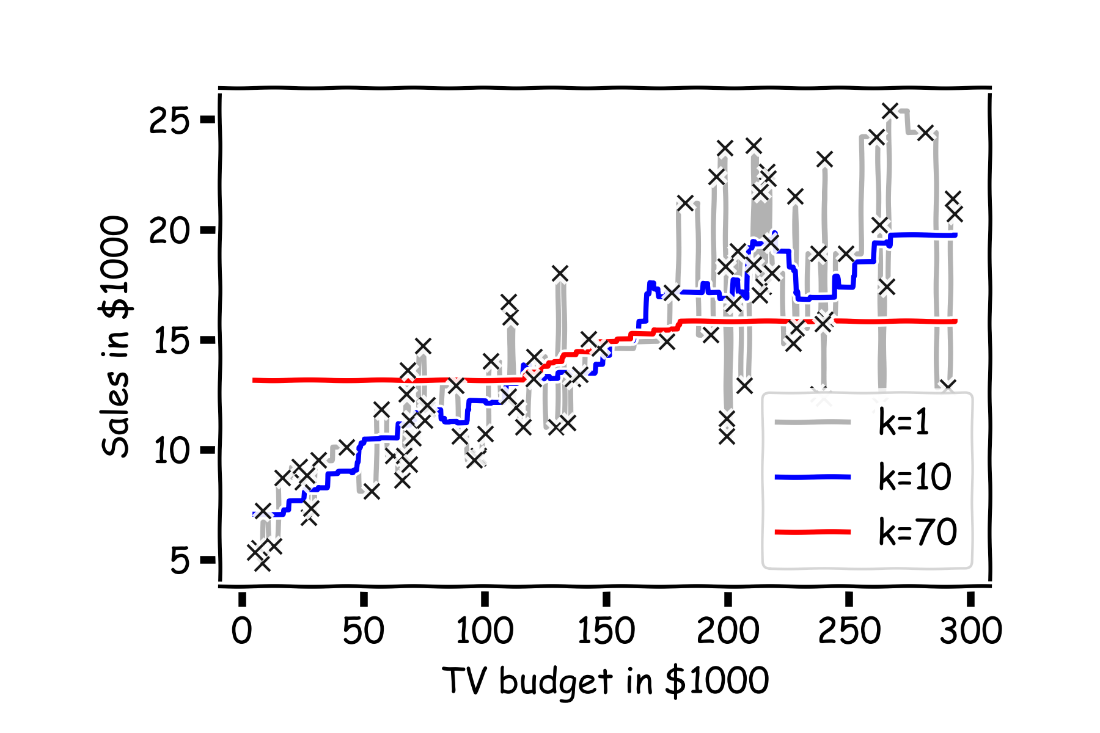
Choice of k matters

Slide 14
k-NN for Classification
How can we modify the k-NN approach for classification?
The approach here is the same as for k-NN regression: use the other available observations that are most similar to the observation we are trying to predict (classify into a group) based on the predictors at hand.
How do we classify which category a specific observation should be in based on its nearest neighbors?

Slide 15
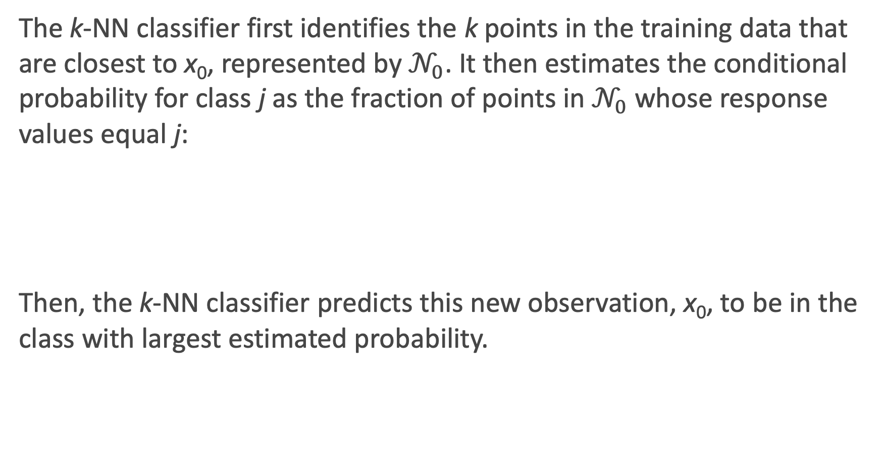
k-NN for Classification: formal definition
The k-NN classifier first identifies the k points in the training data that are closest to x₀, represented by $𝒩_{0}$. It then estimates the conditional probability for class j as the fraction of points in $𝒩_{0}$ whose response values equal j:
Then, the k-NN classifier predicts this new observation, x₀, to be in the class with largest estimated probability.
$$P\left(Y=j | X=x_{0}\right)=\frac{1}{k}\sum_{i{∈𝒩}_{0}}{I(y_{i}=j)}$$

Slide 16
Estimated Probabilities in k-NN Classification

Slide 17
k-NN for Classification (cont.)
There are some issues that may arise:
How can we handle a tie?
What could be a major problem with always classifying to the most common group amongst the neighbors?
How can we handle this?

Slide 18
k-NN Classification in Python
Performing kNN classification in python is done via KNeighborsClassifier in sklearn.neighbors.
An example:

Slide 19
Pure Classifications in k-NN Classification Models
Pure Classifications: Estimated Probabilities:
What will these plots look like when there are 2 predictors? Or 3+ predictors?
This is our first glimpse at a classification boundary (more to come).

Slide 20
k-NN with Multiple Predictors
How could we extend k-NN (both regression and classification) when there are multiple predictors?
We would need to define a measure of distance for observations in order to which are the most similar to the observation we are trying to predict.
Euclidean distance is a good option. To measure the distance of a new observation, x₀ from each observation in the data set, x_{i}:
$$D^{2}\left(x_{i},x_{0}\right)=\sum_{j=1}^{P}{{\left(x_{i,j}−x_{0,j}\right)}^{2}}$$

Slide 21
k-NN with Multiple Predictors (cont.)
But what must we be careful about when measuring distance?
1. Differences in variability in our predictors!
2. Having a mixture of quantitative and categorical predictors.
So what should be good practice? To determine closest neighbors when p > 1, you should first standardize the numeric predictors! And you can even standardize the binaries if you want to include them.
How else could we determine closeness in this multi-dimensional setting?

Slide 22
Parametric Modeling: Why not Linear Regression?

Slide 23

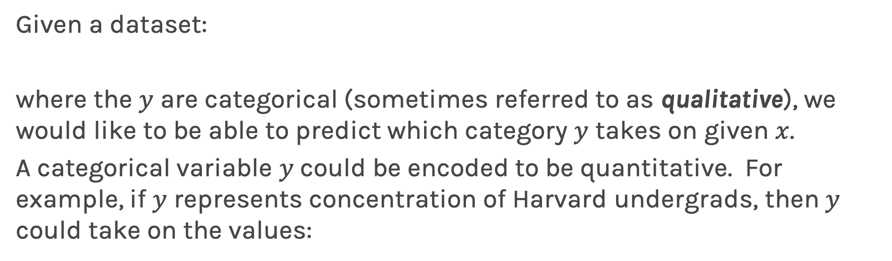
Simple Classification Example
Given a dataset:
where the $y$ are categorical (sometimes referred to as qualitative), we would like to be able to predict which category $y$ takes on given $x$.
A categorical variable $y$could be encoded to be quantitative. For example, if $y$ represents concentration of Harvard undergrads, then $y$ could take on the values:
Linear regression does not work well, or is not appropriate at all, in this setting.
22

Slide 24
Simple Classification Example (cont.)
A linear regression could be used to predict y from x. What would be wrong with such a model?
The model would imply a specific ordering of the outcome, and would treat a one-unit change in y equivalent. The jump from y = 1 to y = 2 (CS to Statistics) should not be interpreted as the same as a jump from y = 2 to y = 3 (Statistics to everyone else).
Similarly, the response variable could be reordered such that y = 1 represents Statistics and y = 2 represents CS, and then the model estimates and predictions would be fundamentally different.
If the categorical response variable was ordinal (had a natural ordering, like class year: Freshman, Sophomore, etc.), then a linear regression model would make some sense but is still not ideal.

Slide 25
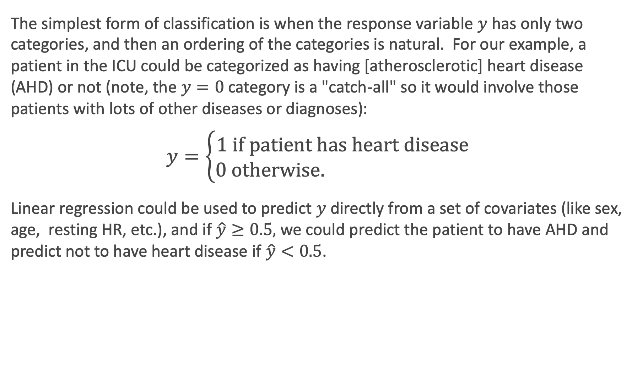
Even Simpler Classification Problem: Binary Response
The simplest form of classification is when the response variable $y$has only two categories, and then an ordering of the categories is natural. For our example, a patient in the ICU could be categorized as having [atherosclerotic] heart disease (AHD) or not (note, the $y=0$ category is a "catch-all" so it would involve those patients with lots of other diseases or diagnoses):
$$y=\left\{\begin{matrix}1 \text{if} \text{patient} \text{has} \text{heart} \text{disease} \\ 0 \text{otherwise}. \end{matrix}\right.$$
Linear regression could be used to predict $y$ directly from a set of covariates (like sex, age, resting HR, etc.), and if $\hat{y}≥0.5,$ we could predict the patient to have AHD and predict not to have heart disease if $\hat{y}<0.5$.

Slide 26
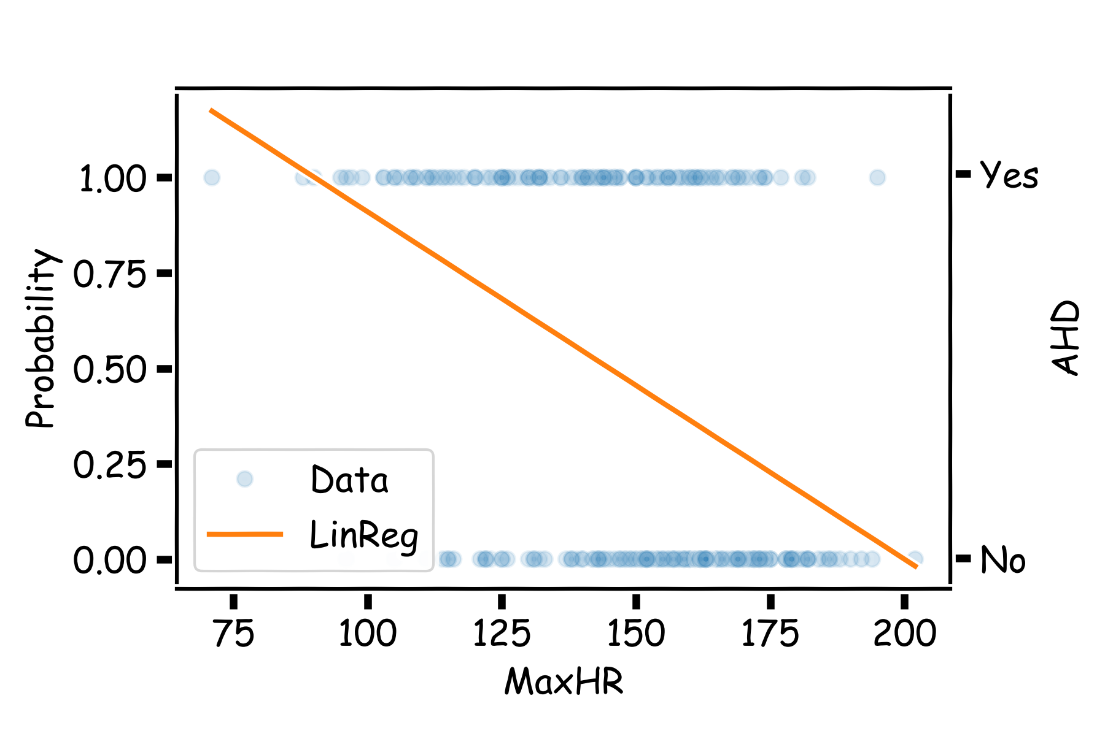
Even Simpler Classification Problem: Binary Response (cont)
What could go wrong with this linear regression model?
.

Slide 27
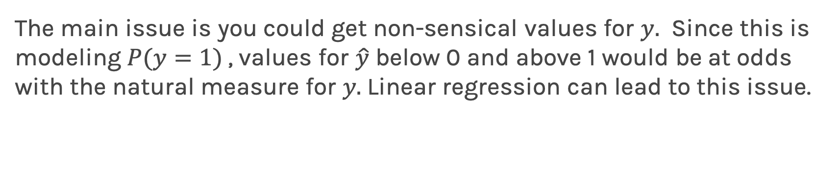
Even Simpler Classification Problem: Binary Response (cont)
The main issue is you could get non-sensical values for $y.$ Since this is modeling $P(y=1)$, values for $\hat{y}$ below 0 and above 1 would be at odds with the natural measure for $y.$Linear regression can lead to this issue.

Slide 28
Binary Response & Logistic Regression

Slide 29
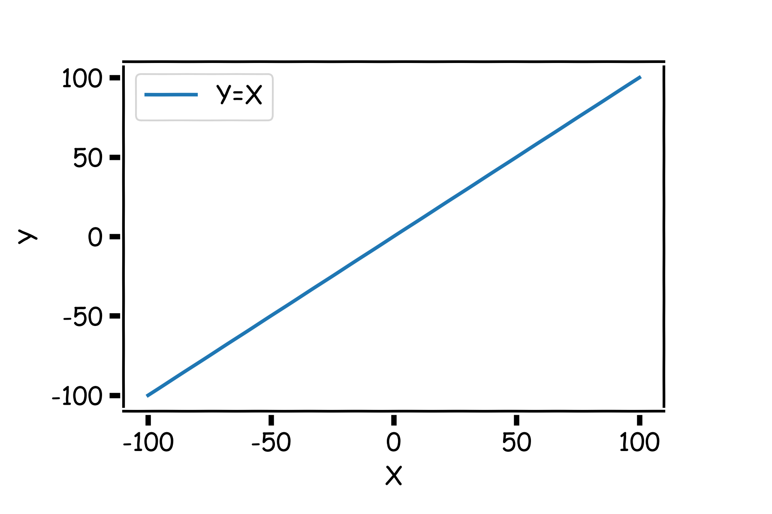
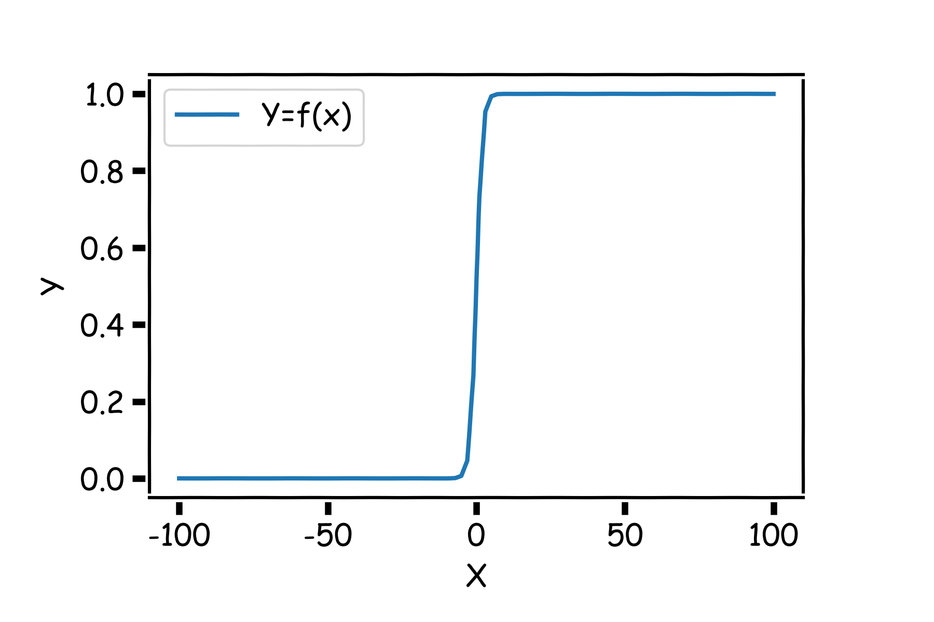
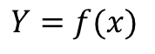
Pavlos Game #45
Think of a function that would do this for us
$$Y=f(x)$$

Slide 30
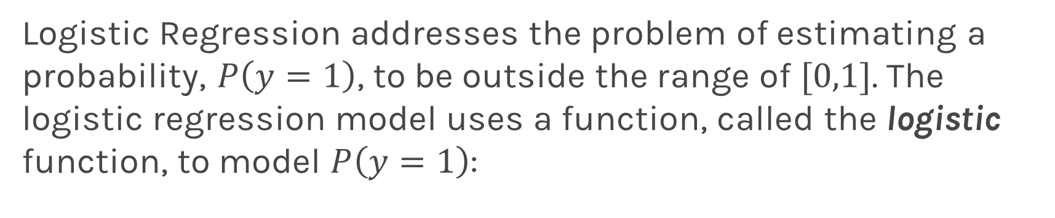
Logistic Regression
Logistic Regression addresses the problem of estimating a probability, $P\left(y=1\right)$, to be outside the range of $[0,1]$. The logistic regression model uses a function, called the logistic function, to model $P\left(y=1\right)$:

Slide 31
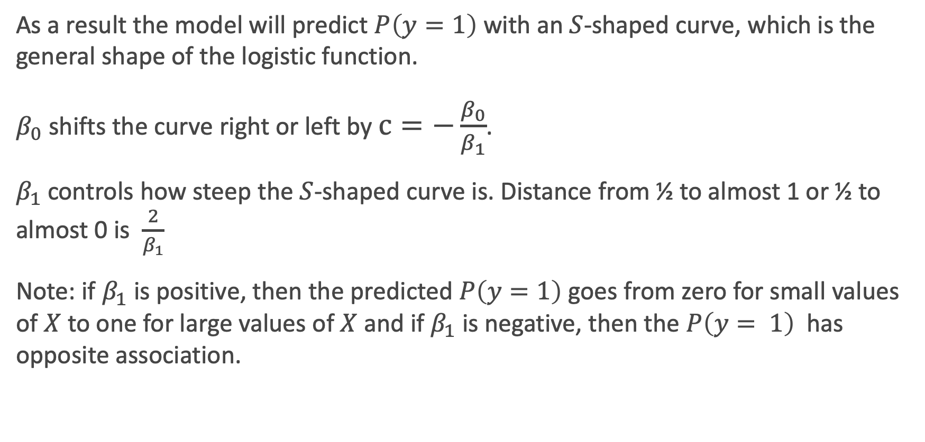
Logistic Regression
As a result the model will predict $P\left(y=1\right)$ with an $S$-shaped curve, which is the general shape of the logistic function.
$β_{0}$ shifts the curve right or left by $c=−\frac{β_{0}}{β_{1}}$.
$β_{1}$controls how steep the $S$-shaped curve is. Distance from ½ to almost 1 or ½ to almost 0 is $\frac{2}{β_{1}}$
Note: if $β_{1}$is positive, then the predicted $P\left(y=1\right)$goes from zero for small values of $X$to one for large values of $X$ and if $β_{1}$is negative, then the $P\left(y= 1\right)$ has opposite association.

Slide 32
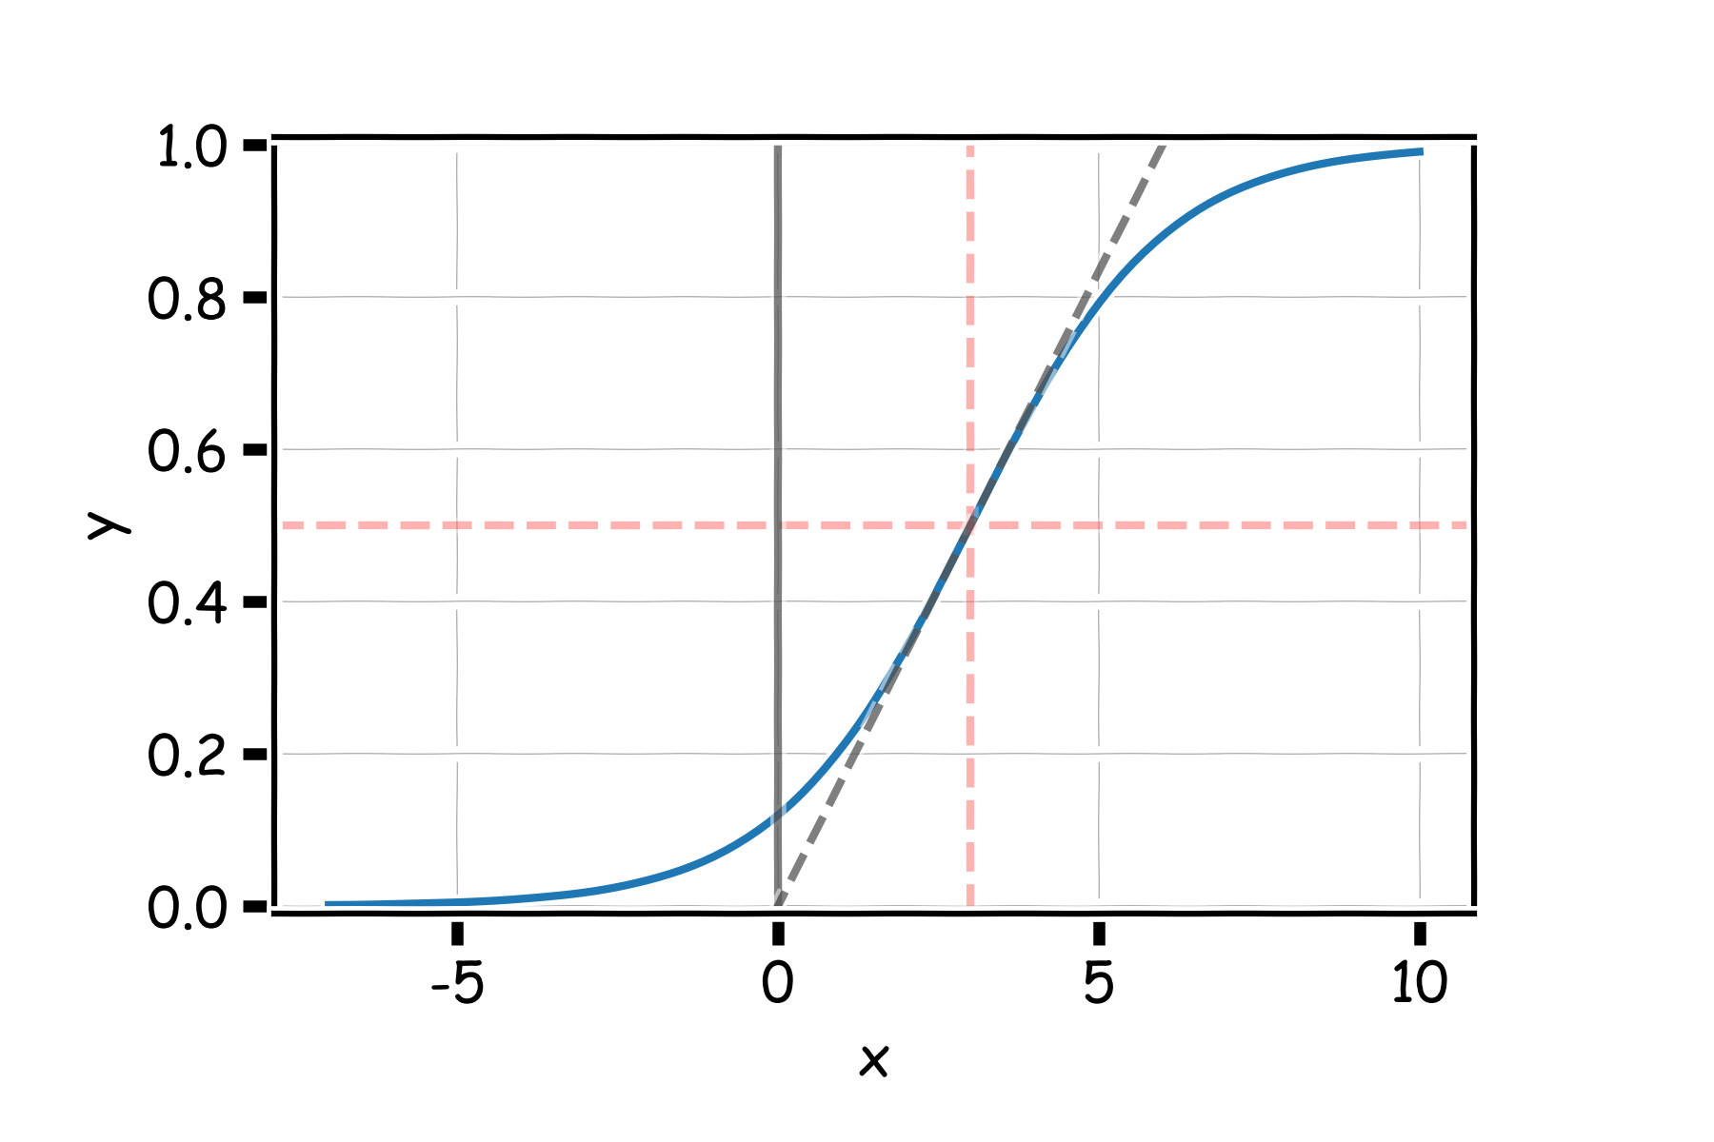
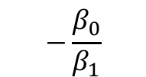


Logistic Regression
$$2β_{1}$$
$$−\frac{β_{0}}{β_{1}}$$
$$\frac{β_{1}}{4}$$

Slide 33
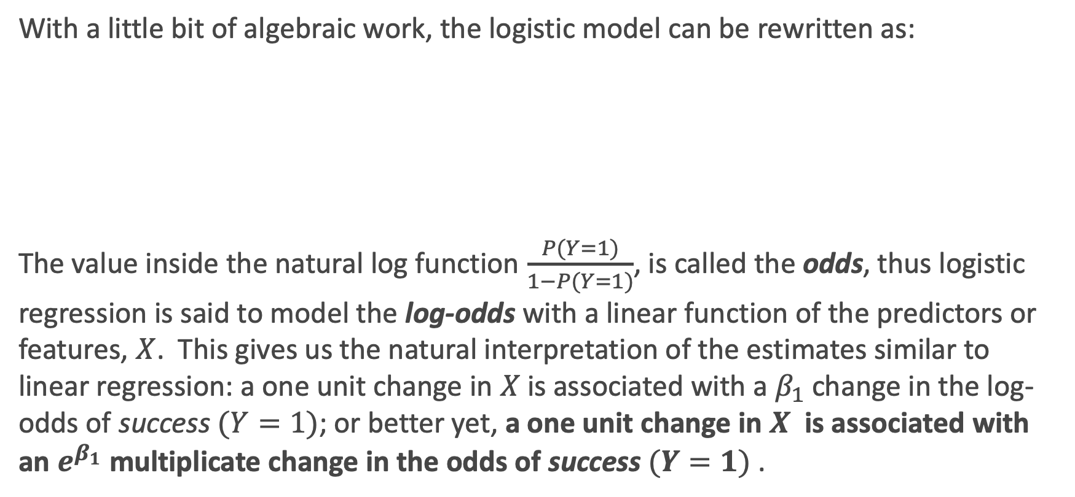
Logistic Regression: interpretation
With a little bit of algebraic work, the logistic model can be rewritten as:
The value inside the natural log function $\frac{P(Y=1)}{1−P(Y=1)}$, is called the odds, thus logistic regression is said to model the log-odds with a linear function of the predictors or features, $X$. This gives us the natural interpretation of the estimates similar to linear regression: a one unit change in $X$ is associated with a $β_{1}$ change in the log-odds of success $(Y=1)$; or better yet, a one unit change in $X$ is associated with an $e^{β_{1}}$ multiplicate change in the odds of success $(Y=1)$.

Slide 34
Exercise Time! Ex. 1: Guesstimating the logistic function (10 min)

Slide 35
Estimating the Simple Logistic Model

Slide 36
Estimation in Logistic Regression
Unlike in linear regression where there exists a closed-form solution to finding the estimates, ${\hat{β}}_{j}$’s, for the true parameters, logistic regression estimates cannot be calculated through simple matrix multiplication.
Questions:
In linear regression what loss function was used to determine the parameter estimates?
What was the probabilistic perspective on linear regression?
Logistic Regression also has a likelihood based approach to estimating parameter coefficients.

Slide 37
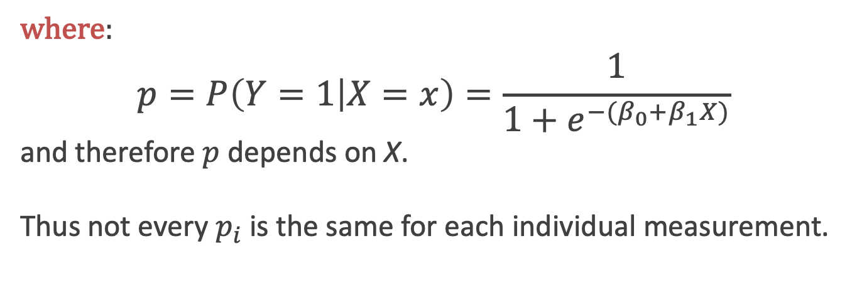
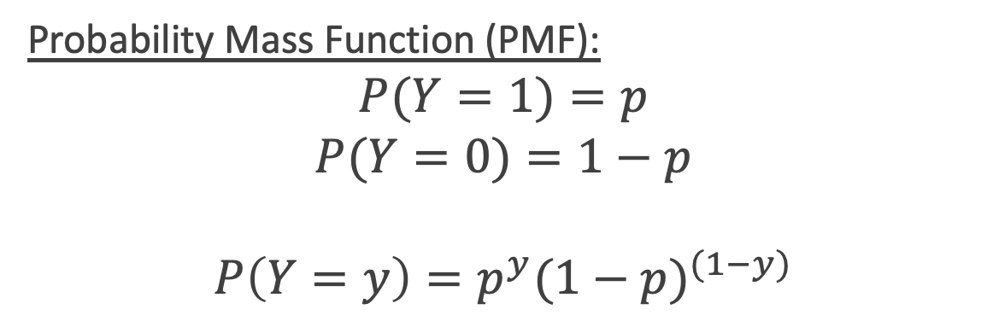
Estimation in Logistic Regression
Probability Mass Function (PMF):
$$P(Y=1)=p$$
$$P(Y=0)=1−p$$
$${P\left(Y=y\right)=p}^{y}{(1−p)}^{(1−y)}$$
where:
$$p=P\left(Y=1 | X=x\right)=\frac{1}{1+e^{−(β_{0}+β_{1}X)}}$$
and therefore $p$depends on X.
Thus not every $p_{i}$ is the same for each individual measurement.

Slide 38
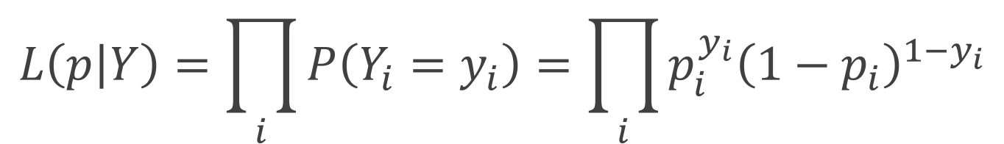

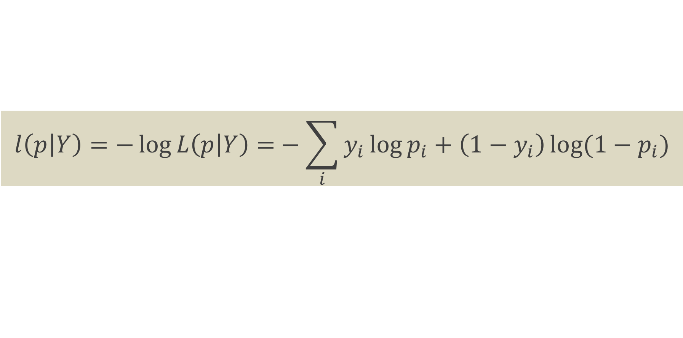
Likelihood
The likelihood of a single observation for p given x and y is:
Given the observations are independent, what is the likelihood function for p?
$$L\left(p_{i} | Y_{i}\right)=P\left(Y_{i}=y_{i}\right)=p_{i}^{y_{i}}{\left(1−p_{i}\right)}^{1−y_{i}}$$
$$L\left(p | Y\right)=\prod_{i}{P\left(Y_{i}=y_{i}\right)=\prod_{i}{p_{i}^{y_{i}}{\left(1−p_{i}\right)}^{1−y_{i}}}}$$
$$l\left(p | Y\right)=−\log{L\left(p | Y\right)=}−\sum_{i}{y_{i}\log{p_{i}+\left(1−y_{i}\right)\log{(1−p_{i})}}}$$

Slide 39
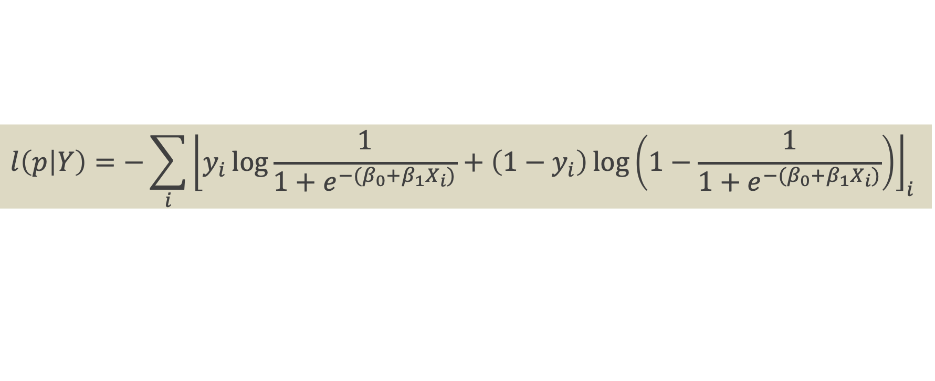
Loss Function
$$l\left(p | Y\right)=−\sum_{i}{{\left\lfloor y_{i}\log{\frac{1}{1+e^{−(β_{0}+{β_{1}X}_{i})}}+\left(1−y_{i}\right)\log\left(1−\frac{1}{1+e^{−(β_{0}+{β_{1}X}_{i})}}\right)}\right\rfloor }_{i} }$$
How do we minimize this?
Differentiate, equate to zero and solve for it!
But jeeze does this look messy?! It will not necessarily have a closed form solution.
So how do we determine the parameter estimates? Through an iterative approach (we will talk about this at length in future lectures).

Slide 40
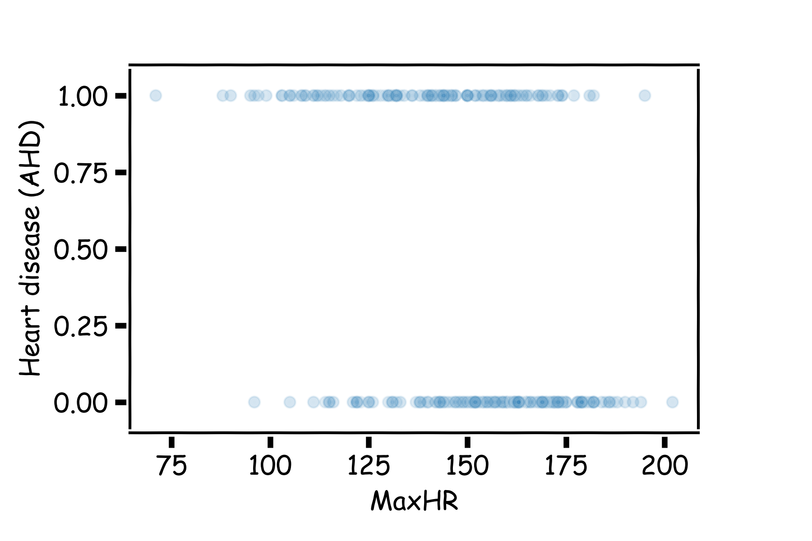
Heart Data: logistic estimation
We'd like to predict whether or not a person has a heart disease. And we'd like to make this prediction, for now, just based on the MaxHR.
How should we visualize these data?

Slide 41
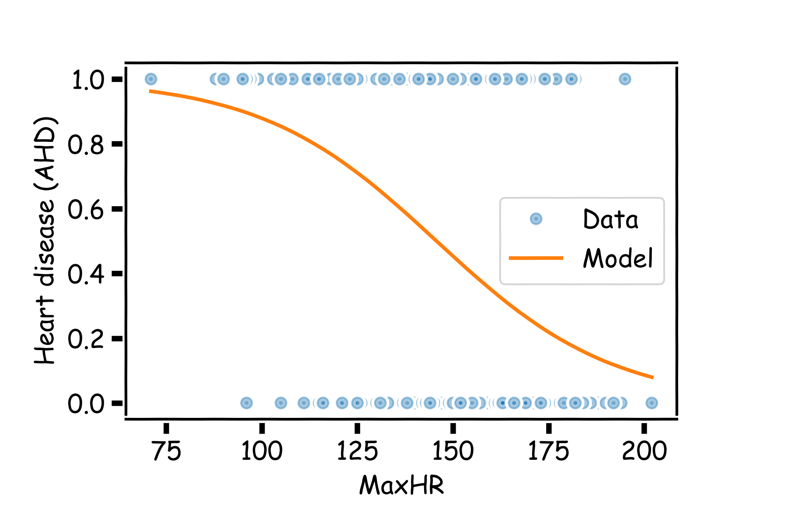
Heart Data: logistic estimation

Slide 42
Heart Data: logistic estimation
There are various ways to fit a logistic model to this data set in Python. The most straightforward in sklearn is via linear_model.LogisticRegression.

Slide 43
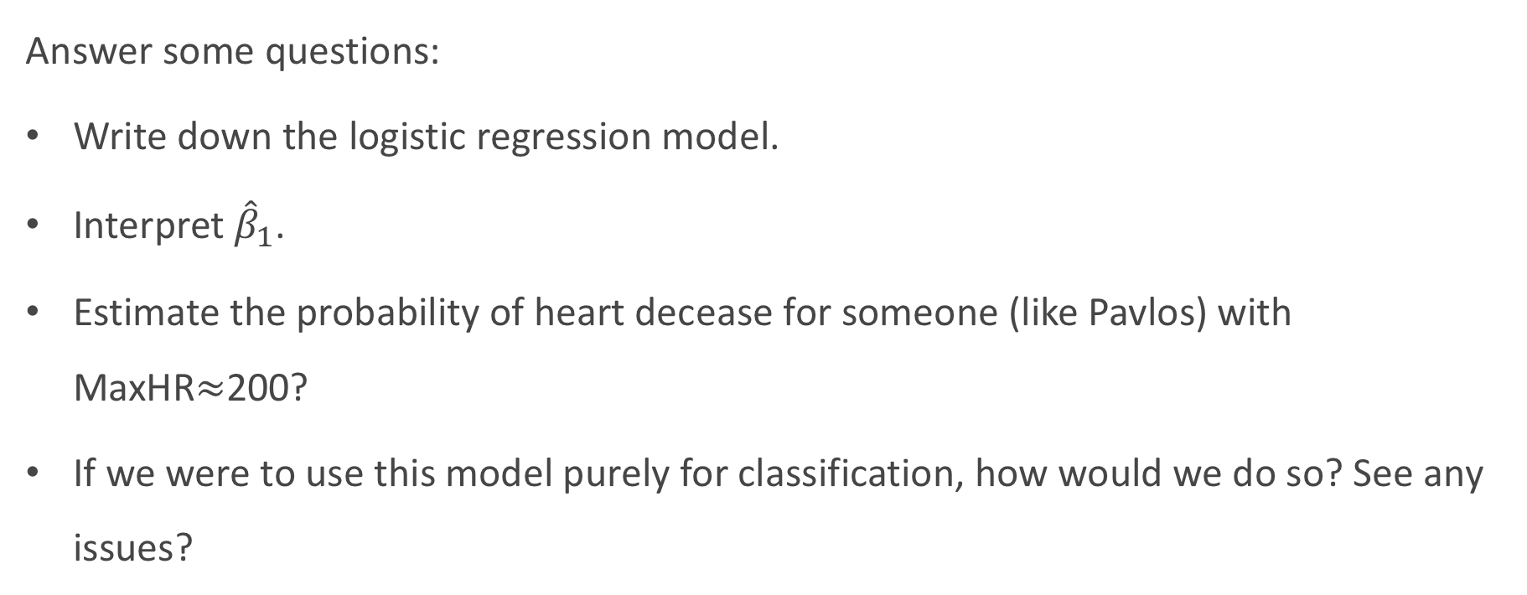
Heart Data: logistic estimation
Answer some questions:
Write down the logistic regression model.
Interpret ${\hat{β}}_{1}$.
Estimate the probability of heart decease for someone (like Pavlos) with MaxHR$≈$200?
If we were to use this model purely for classification, how would we do so? See any issues?

Slide 44
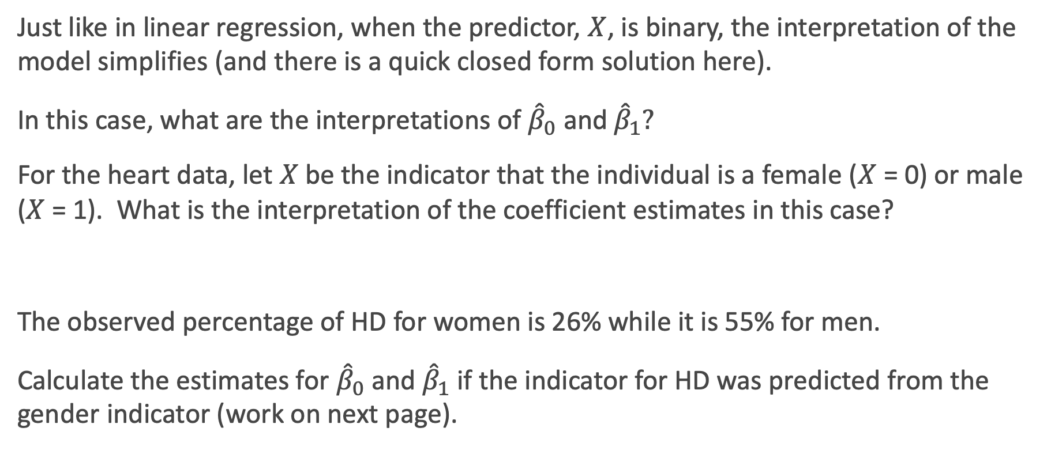
Categorical Predictors
Just like in linear regression, when the predictor, $X$, is binary, the interpretation of the model simplifies (and there is a quick closed form solution here).
In this case, what are the interpretations of ${\hat{β}}_{0}$and ${\hat{β}}_{1}?$
For the heart data, let $X$be the indicator that the individual is a female ($X$ = 0) or male ($X$ = 1). What is the interpretation of the coefficient estimates in this case?
The observed percentage of HD for women is 26% while it is 55% for men.
Calculate the estimates for ${\hat{β}}_{0}$and ${\hat{β}}_{1}$ if the indicator for HD was predicted from the gender indicator (work on next page).

Slide 45
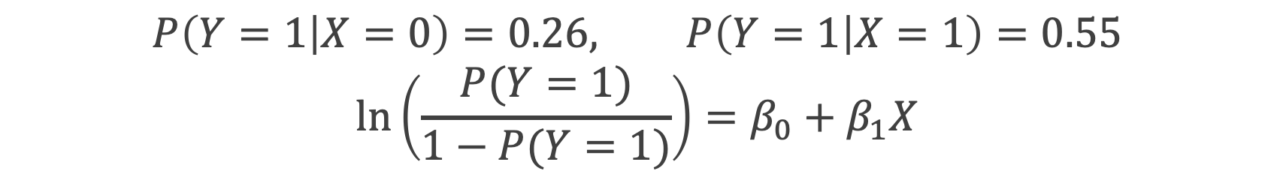
Solving for the estimates mathematically:
$$P\left(Y=1 | X=0\right)=0.26, P\left(Y=1 | X=1\right)=0.55$$
$$\ln\left(\frac{P(Y=1)}{1−P(Y=1)}\right)=β_{0}+β_{1}X$$

Slide 46
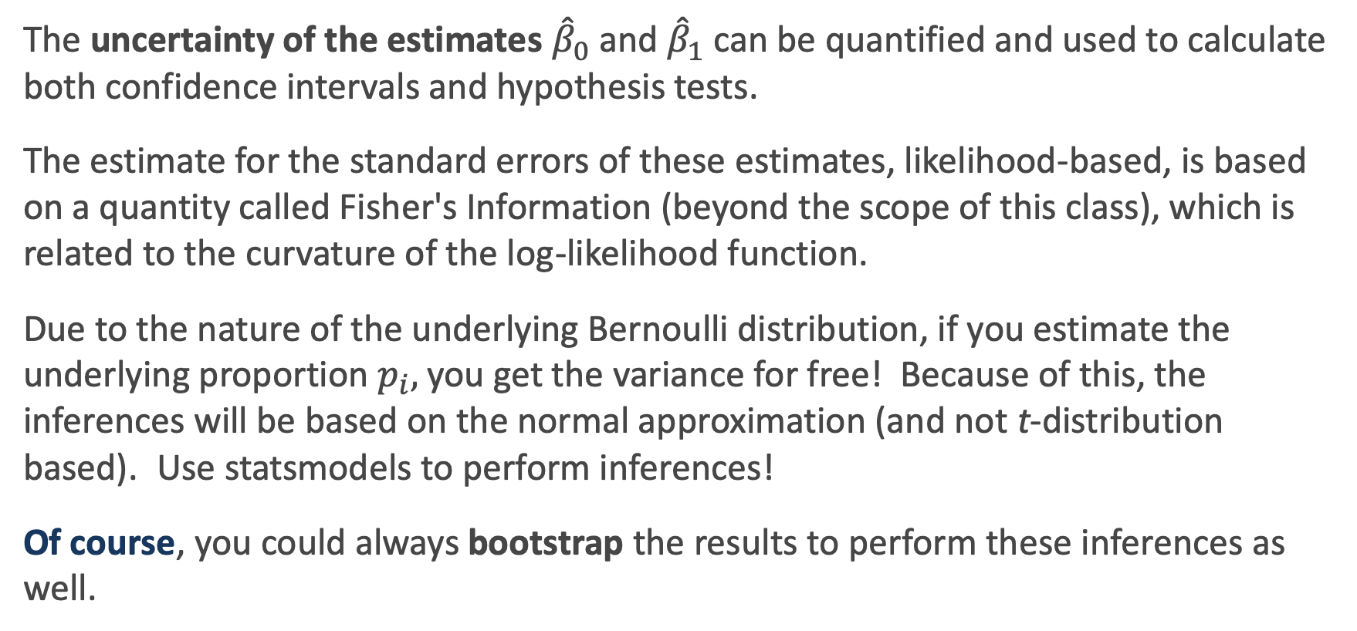
Statistical Inference in Logistic Regression
The uncertainty of the estimates ${\hat{β}}_{0}$and ${\hat{β}}_{1}$ can be quantified and used to calculate both confidence intervals and hypothesis tests.
The estimate for the standard errors of these estimates, likelihood-based, is based on a quantity called Fisher's Information (beyond the scope of this class), which is related to the curvature of the log-likelihood function.
Due to the nature of the underlying Bernoulli distribution, if you estimate the underlying proportion $p_{i},$you get the variance for free! Because of this, the inferences will be based on the normal approximation (and not t-distribution based). Use statsmodels to perform inferences!
Of course, you could always bootstrap the results to perform these inferences as well.

Slide 47
Classification using the Logistic Model

Slide 48
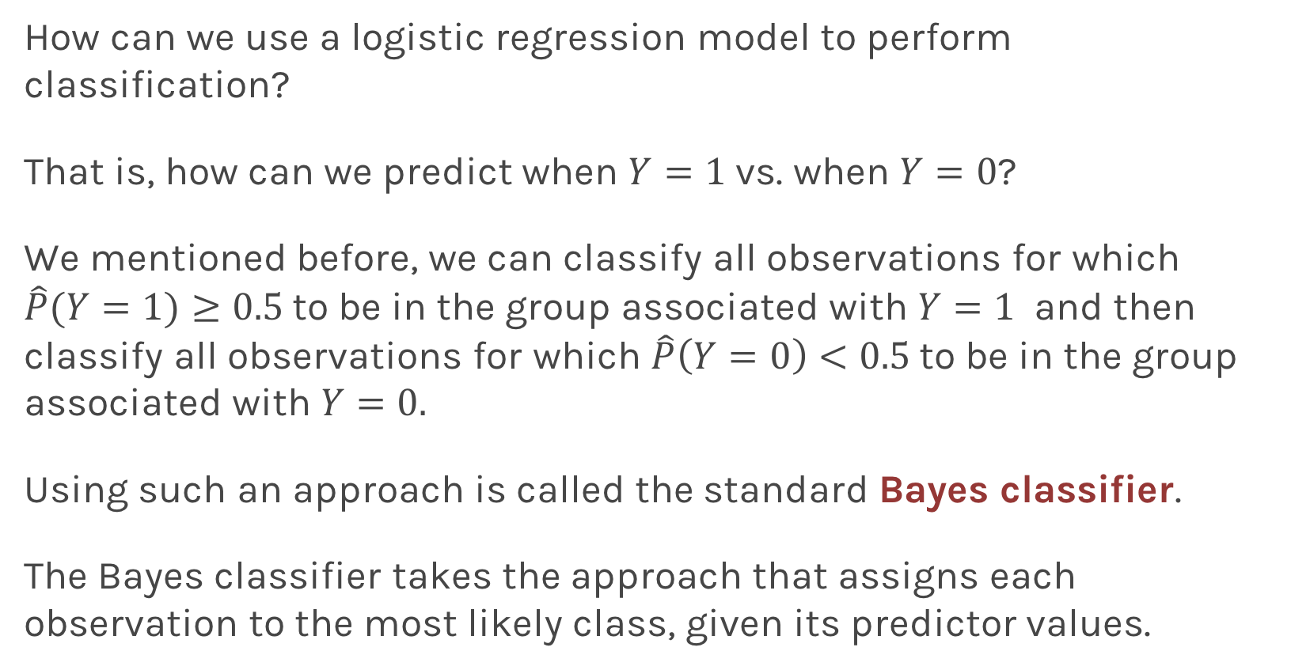
Using Logistic Regression for Classification
How can we use a logistic regression model to perform classification?
That is, how can we predict when $Y=1$ vs. when $Y=0$?
We mentioned before, we can classify all observations for which $\hat{P}(Y=1)≥0.5$to be in the group associated with $Y=1$ and then classify all observations for which $\hat{P}\left(Y=0\right)<0.5$to be in the group associated with $Y=0.$
Using such an approach is called the standard Bayes classifier.
The Bayes classifier takes the approach that assigns each observation to the most likely class, given its predictor values.

Slide 49
Using Logistic Regression for Classification
When will this Bayes classifier be a good one? When will it be a poor one?
The Bayes classifier is the one that minimizes the overall classification error rate. That is, it minimizes:
Is this a good Loss function to minimize? Why or why not?
The Bayes classifier may be a poor indicator within a group. Think about the Heart Data scatter plot...

Slide 50

Using Logistic Regression for Classification
This has potential to be a good classifier if the predicted probabilities are on both sides of 0 and 1.
How do we extend this classifier if $Y$ has more than two categories?

Slide 51
Multiple Logistic Regression

Slide 52
Multiple Logistic Regression
It is simple to illustrate examples in logistic regression when there is just one predictors variable.
But the approach ‘easily’ generalizes to the situation where there are multiple predictors.
A lot of the same details as linear regression apply to logistic regression. Interactions can be considered. Multicollinearity is a concern. So is overfitting. Etc...
So how do we correct for such problems?
Regularization and checking though train, test, and cross-validation!
We will get into the details of this, along with other extensions of logistic regression, in the next lecture.

Slide 53
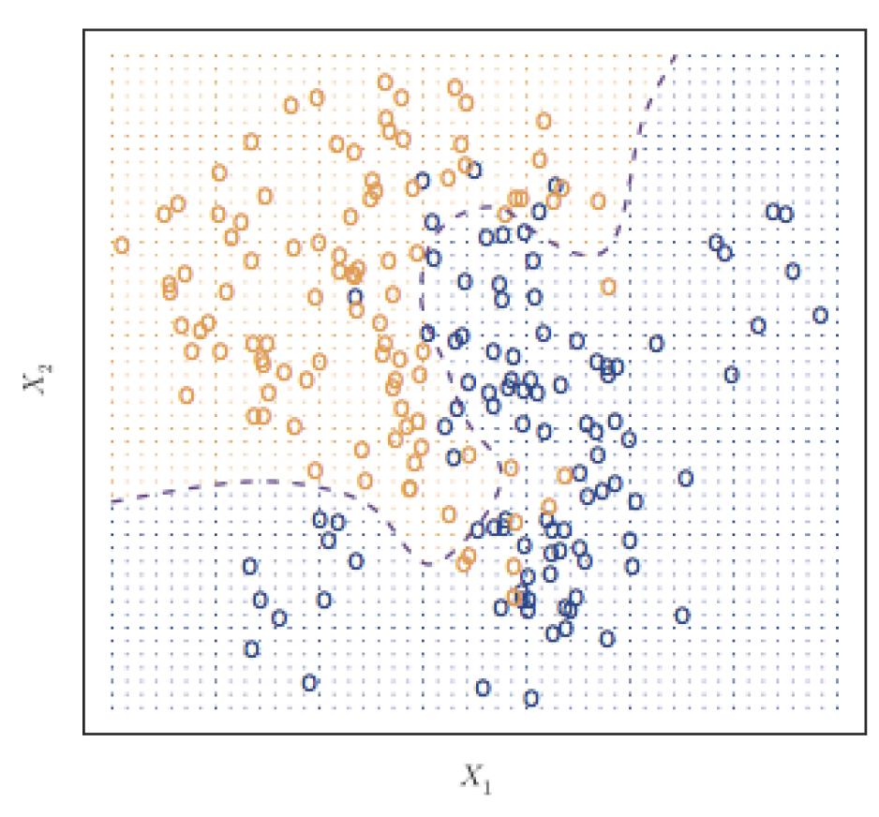
Classifier with two predictors
How can we estimate a classifier, based on logistic regression, for the following plot?

Slide 54
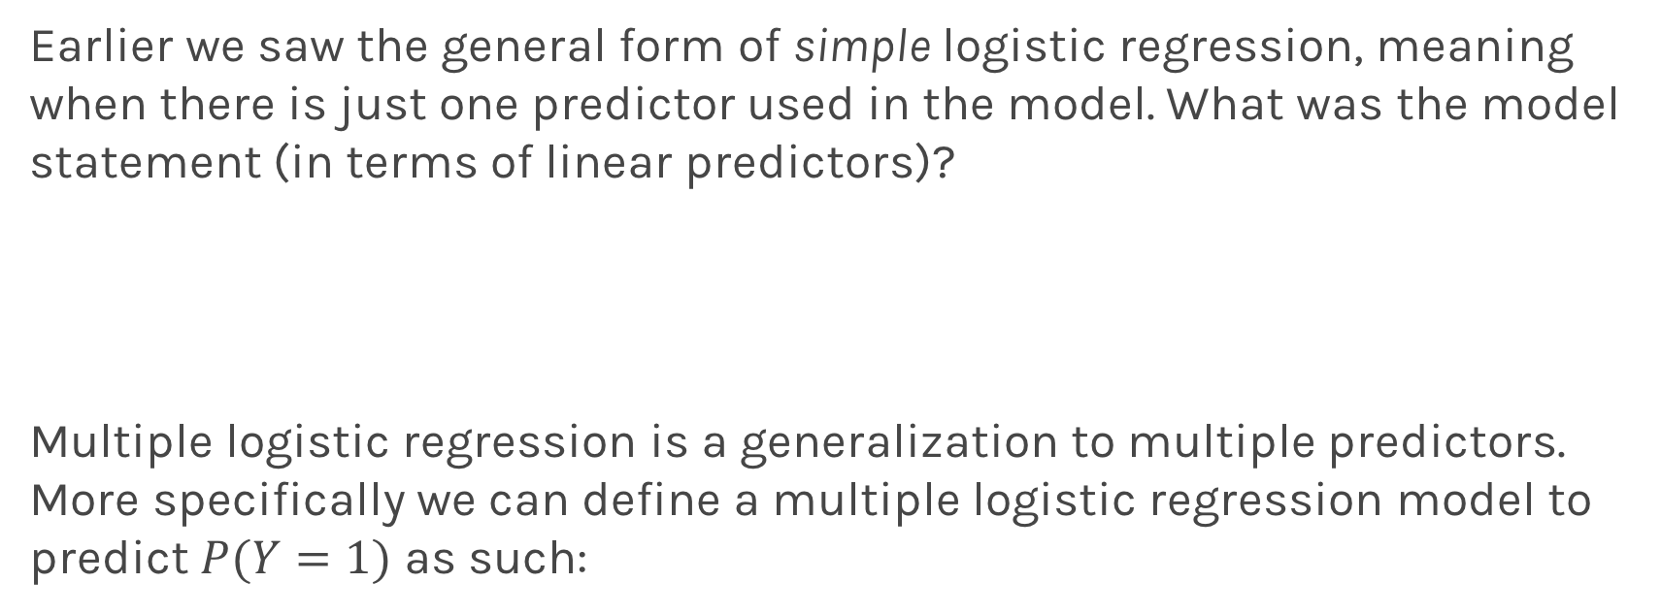
Multiple Logistic Regression
Earlier we saw the general form of simple logistic regression, meaning when there is just one predictor used in the model. What was the model statement (in terms of linear predictors)?
Multiple logistic regression is a generalization to multiple predictors. More specifically we can define a multiple logistic regression model to predict $P(Y=1)$ as such:

Slide 55
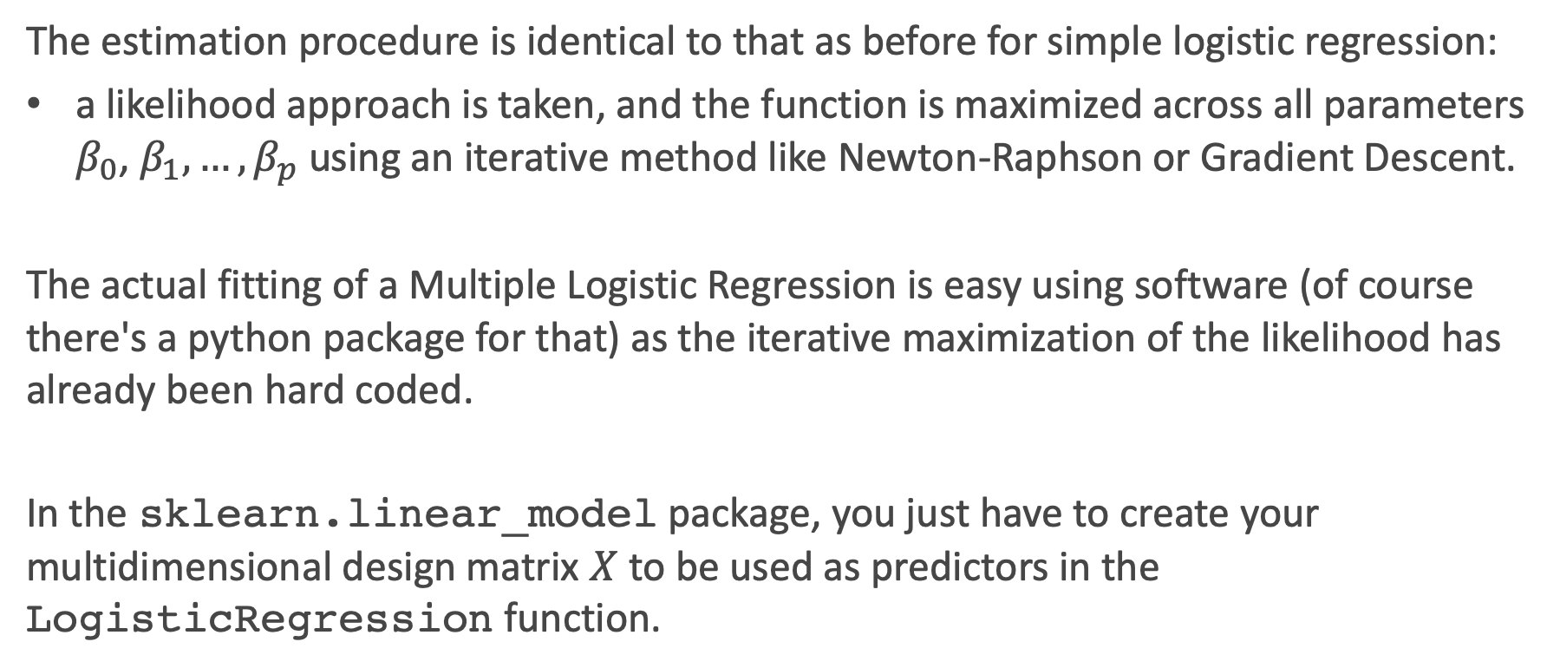
Fitting Multiple Logistic Regression
The estimation procedure is identical to that as before for simple logistic regression:
a likelihood approach is taken, and the function is maximized across all parameters $β_{0}$, $β_{1},…,β_{p}$ using an iterative method like Newton-Raphson or Gradient Descent.
The actual fitting of a Multiple Logistic Regression is easy using software (of course there's a python package for that) as the iterative maximization of the likelihood has already been hard coded.
In the sklearn.linear_model package, you just have to create your multidimensional design matrix $X$ to be used as predictors in the LogisticRegression function.

Slide 56
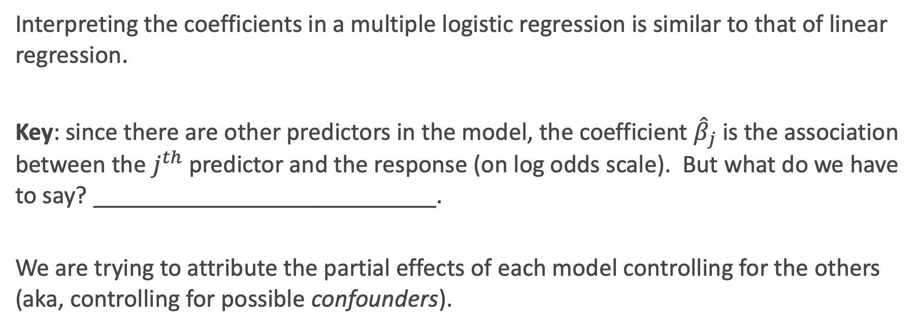
Interpretation of Multiple Logistic Regression
Interpreting the coefficients in a multiple logistic regression is similar to that of linear regression.
Key: since there are other predictors in the model, the coefficient ${\hat{β}}_{j}$ is the association between the $j^{th}$ predictor and the response (on log odds scale). But what do we have to say? ___________________________.
We are trying to attribute the partial effects of each model controlling for the others (aka, controlling for possible confounders).

Slide 57
Interpreting Multiple Logistic Regression: an Example
Let's get back to the Heart Data. We are attempting to predict whether someone has HD based on MaxHR and whether the person is female or male. The simultaneous effect of these two predictors can be brought into one model.
Recall from earlier we had the following estimated models:

Slide 58
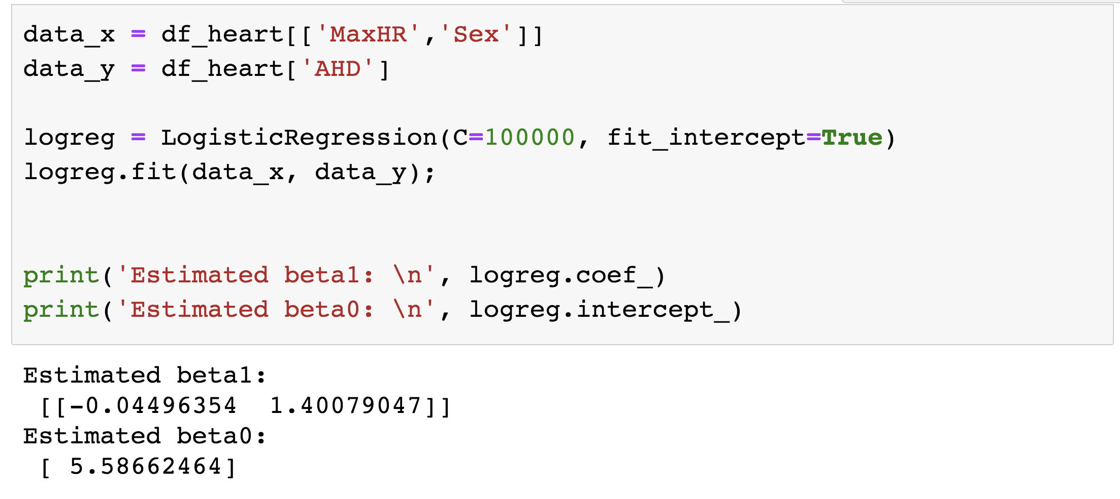
Interpreting Multiple Logistic Regression: an Example
The results for the multiple logistic regression model are:

Slide 59
Some questions
Estimate the odds ratio of HD comparing men to women using this model.
Is there any evidence of multicollinearity in this model?
Is there any confounding in this problem?

Slide 60
Exercise Time! Ex. 2: Simple k-NN and Logistic Regression in sklearn (15+ min)

